Slide 1
PHOTOGRAPHER PORTFOLIO

Slide 2
Requirements
Home Page
About us & Photography
Music page
Service Page
Contact us

Slide 3
Problem Statement
create a new Photographer portfolio that showcases the love for travel & code .It has other options like Home, Music, Photography, Services, About, and Contact as sections.

Slide 4
Primary goals
We purpose an interactive page, that will include
all the features specified by the client.
So, we made up 6 web pages, including
1. Homepage
2. About page
3. Photography page
4. Music page
5. Services page
6. Contact page

Slide 5
USE CASE DIAGRAM

Slide 6
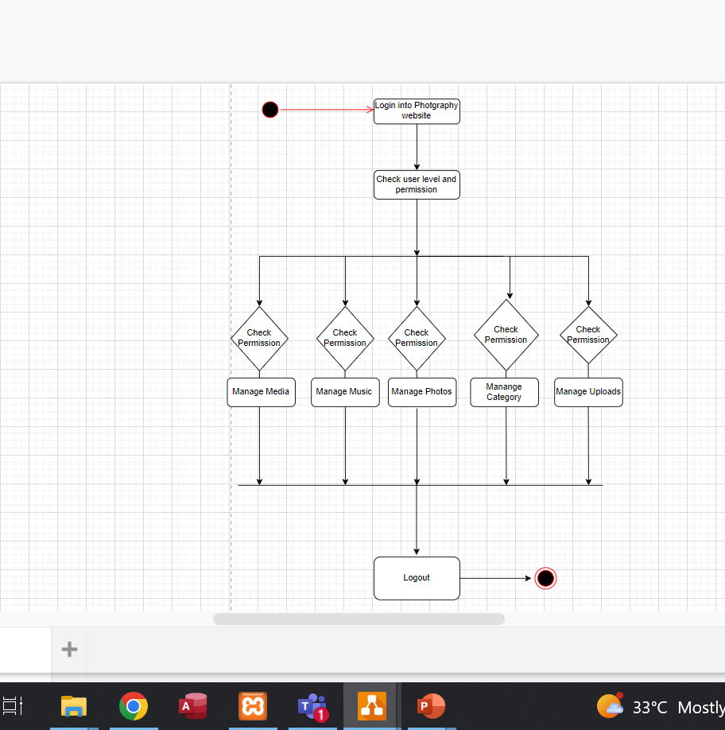
ACTIVITY DIAGRAM

Slide 7
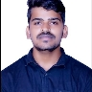
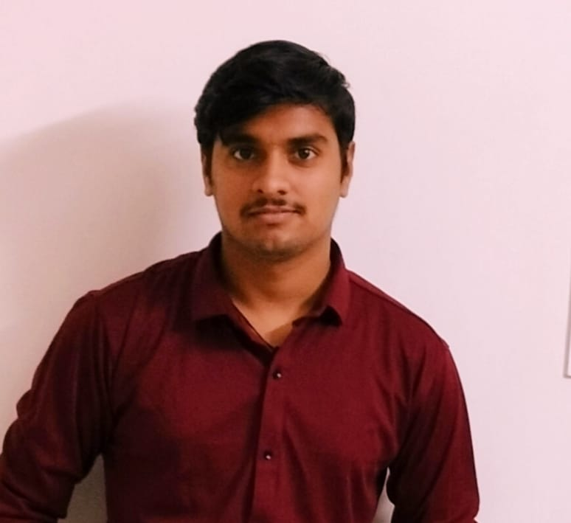
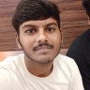
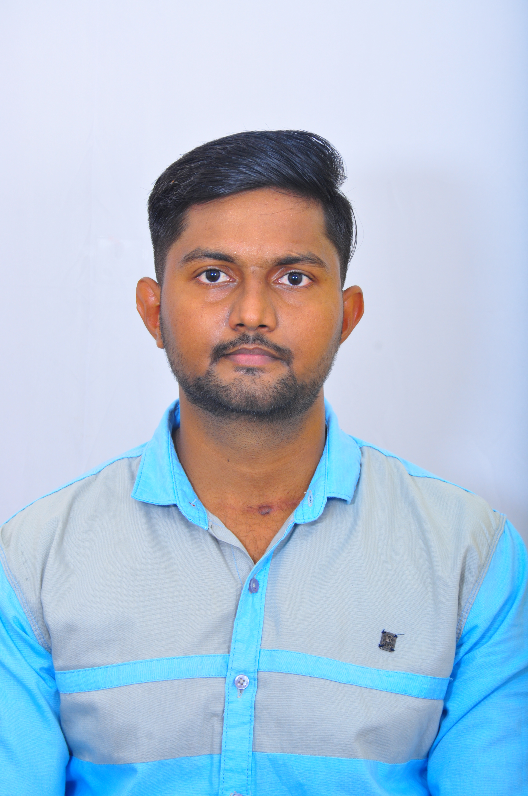
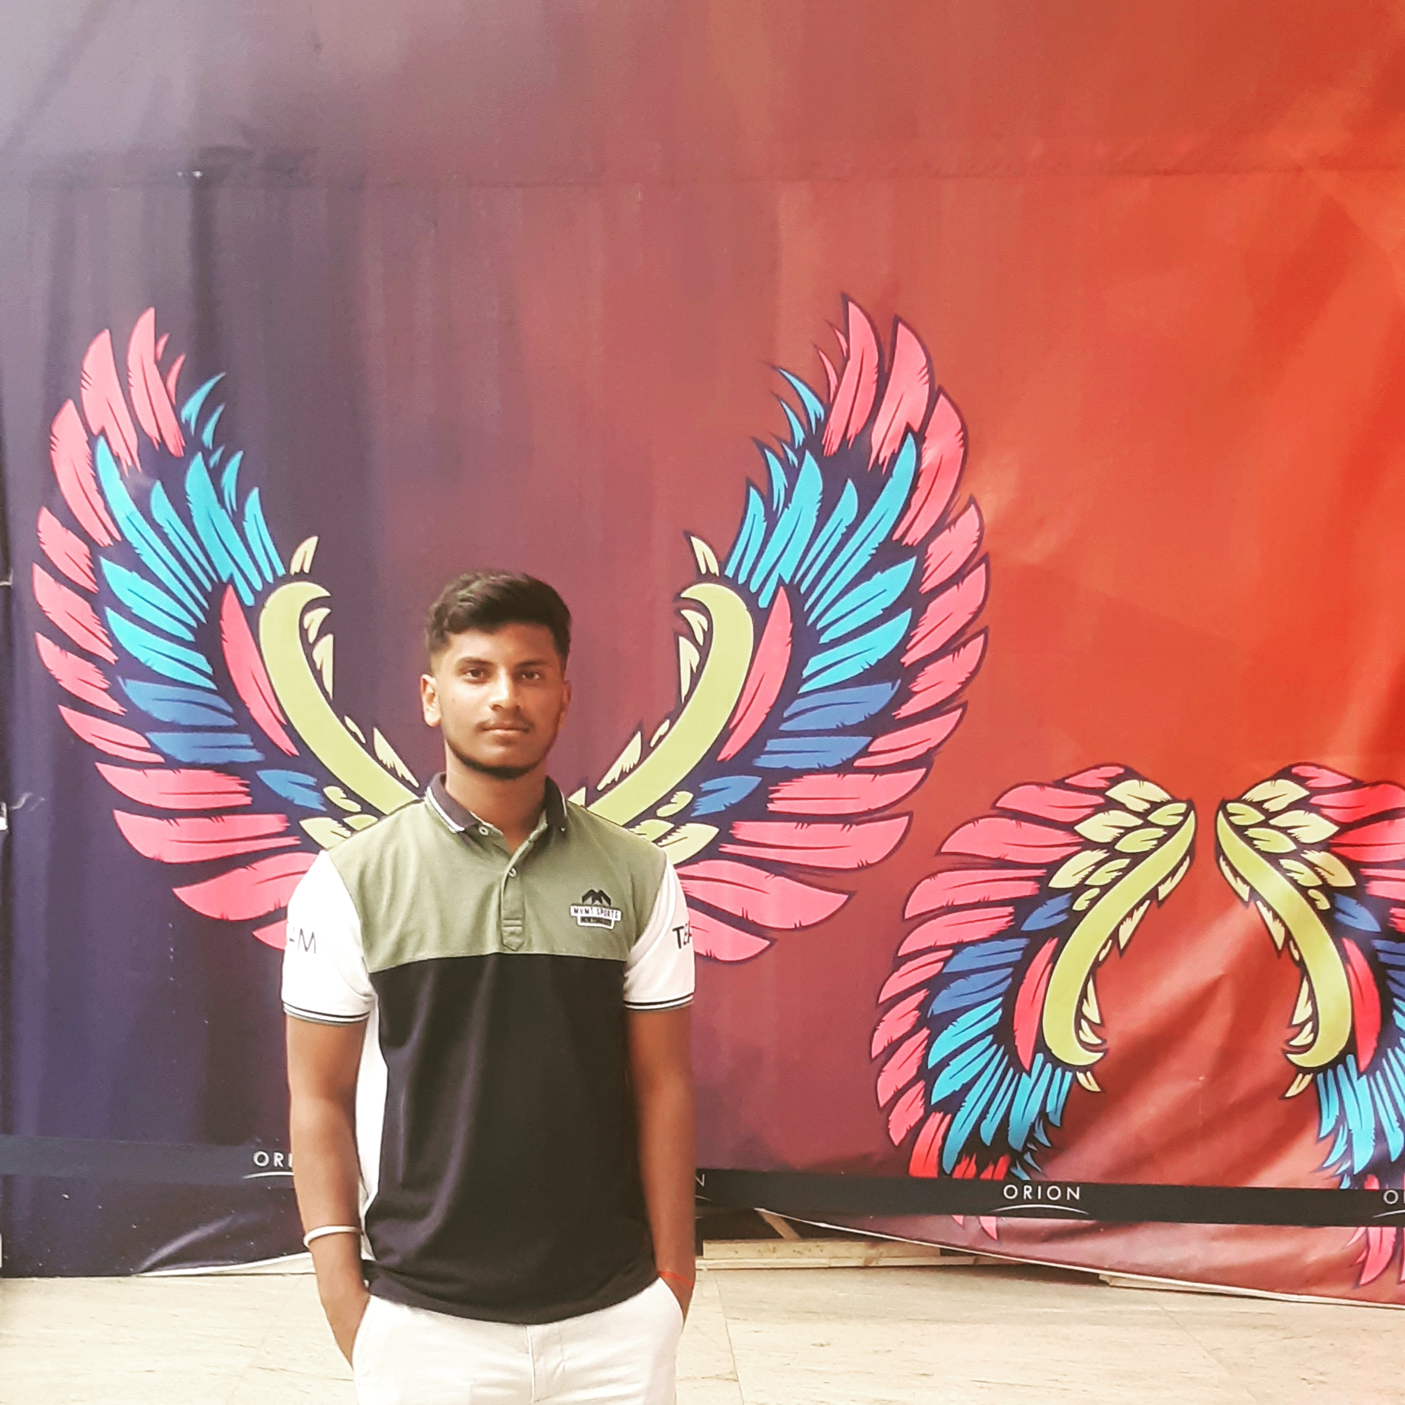
Meet our team
Loganathan
Hareesh Sandenevi
Giridhar Patro
Team Representitator
Front end & Back-end
Front end & Back-end
Vishal
Bharat
Front end & Back-end
Front end & Back-end

Slide 8
Plan for product launch
Deploy strategic networks with compelling e-business needs
Planning
Synergize scalable e-commerce
Marketing
Disseminate standardized metrics
Design
Coordinate
Foster holistically superior methodologies
Launch
Strategy
e-business applications
1
2
3
4
5

Slide 9
Summary
At Contoso, we believe in giving 110%. By using our next-generation data architecture, we help organizations virtually manage agile workflows. We thrive because of our market knowledge and great team behind our product. As our CEO says, "Efficiencies will come from proactively transforming how we do business."

Slide 10
Thank you

